Slide 1


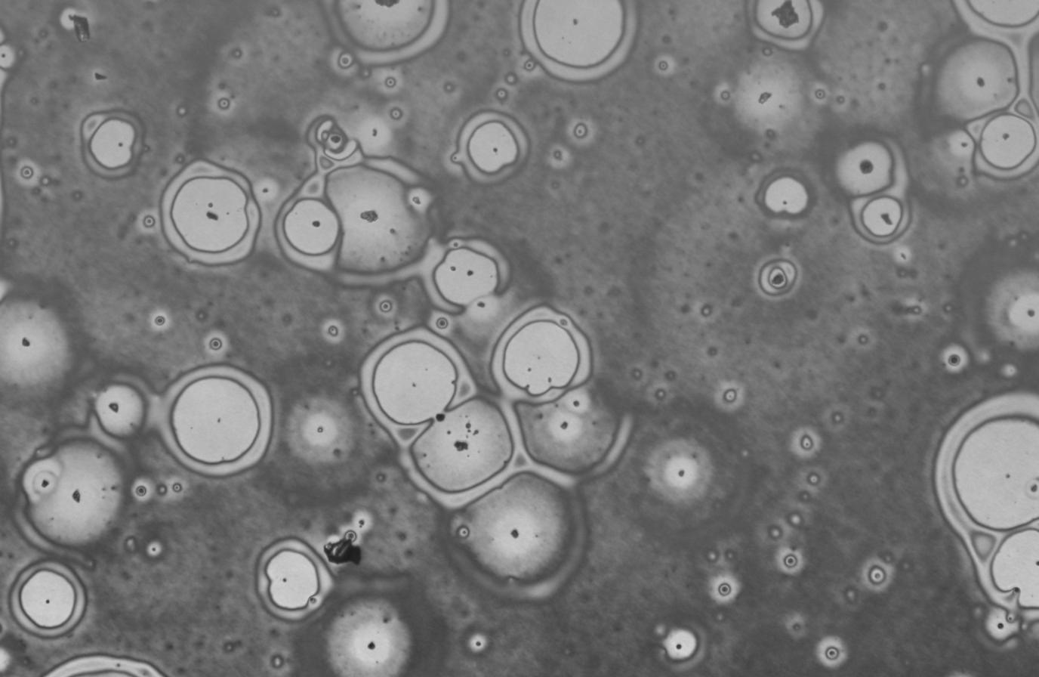
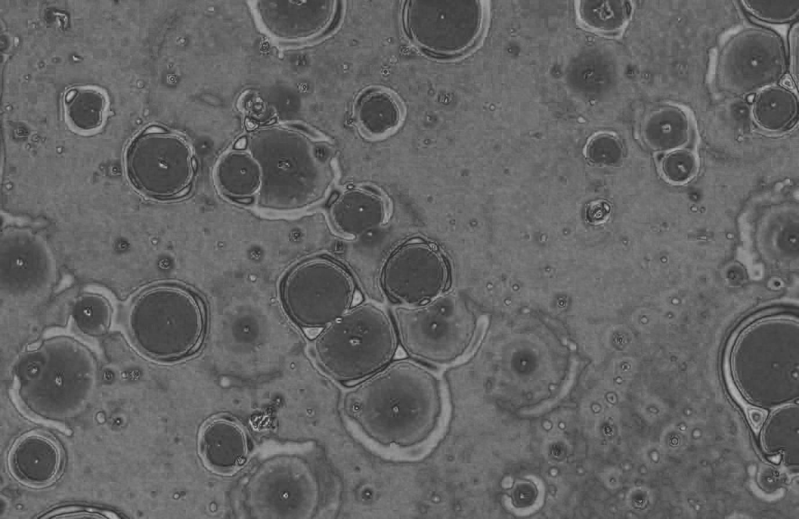
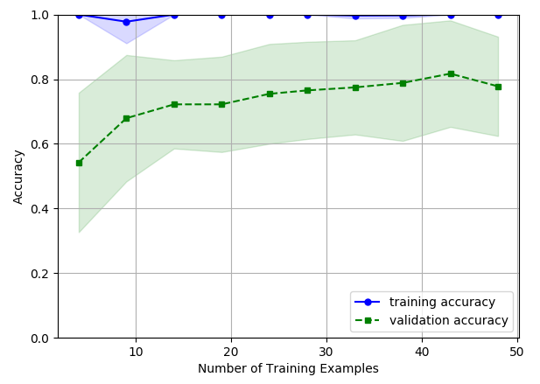
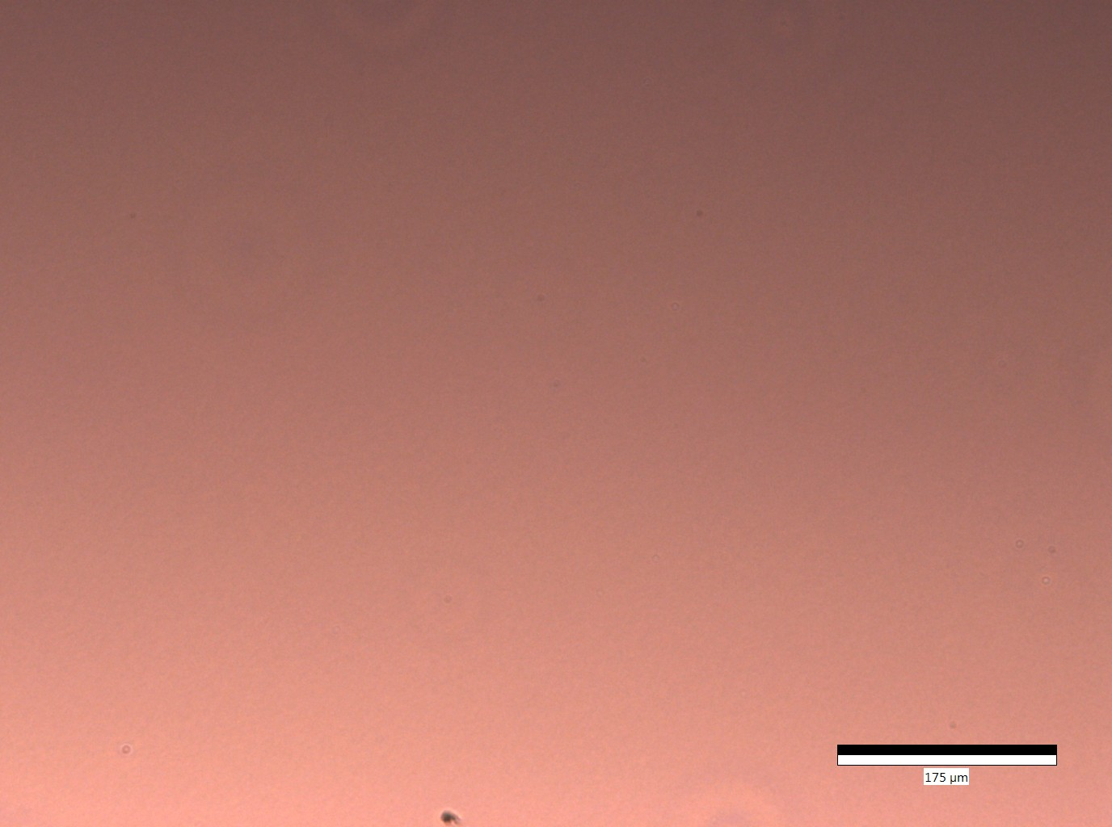
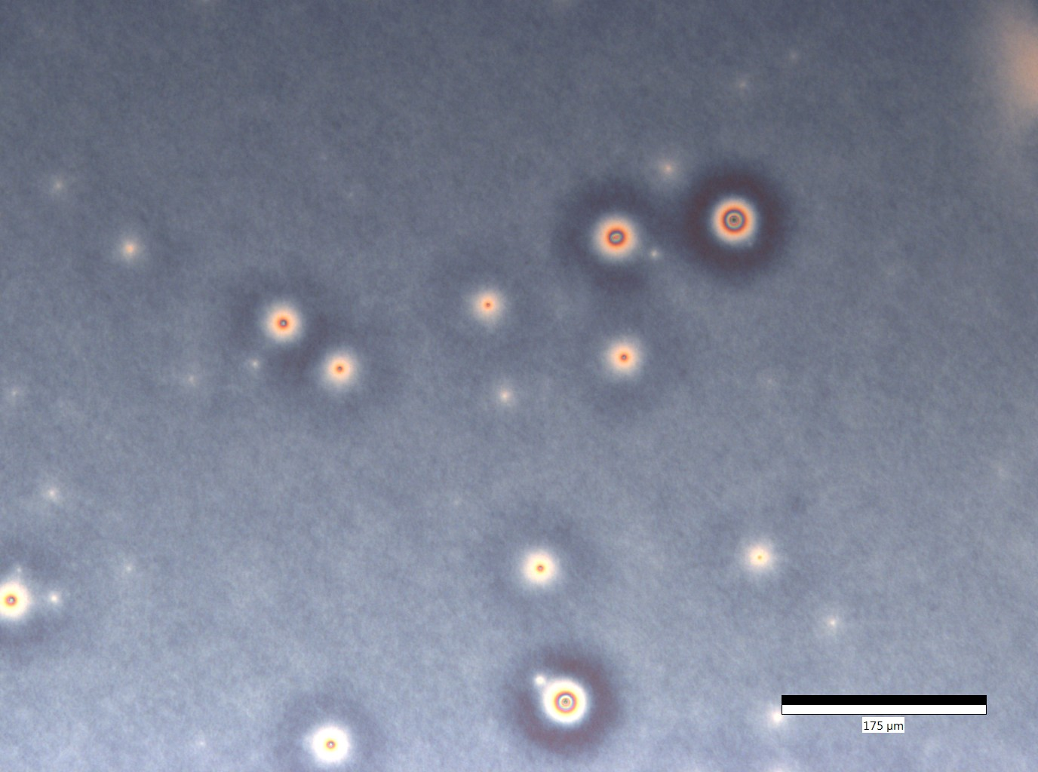
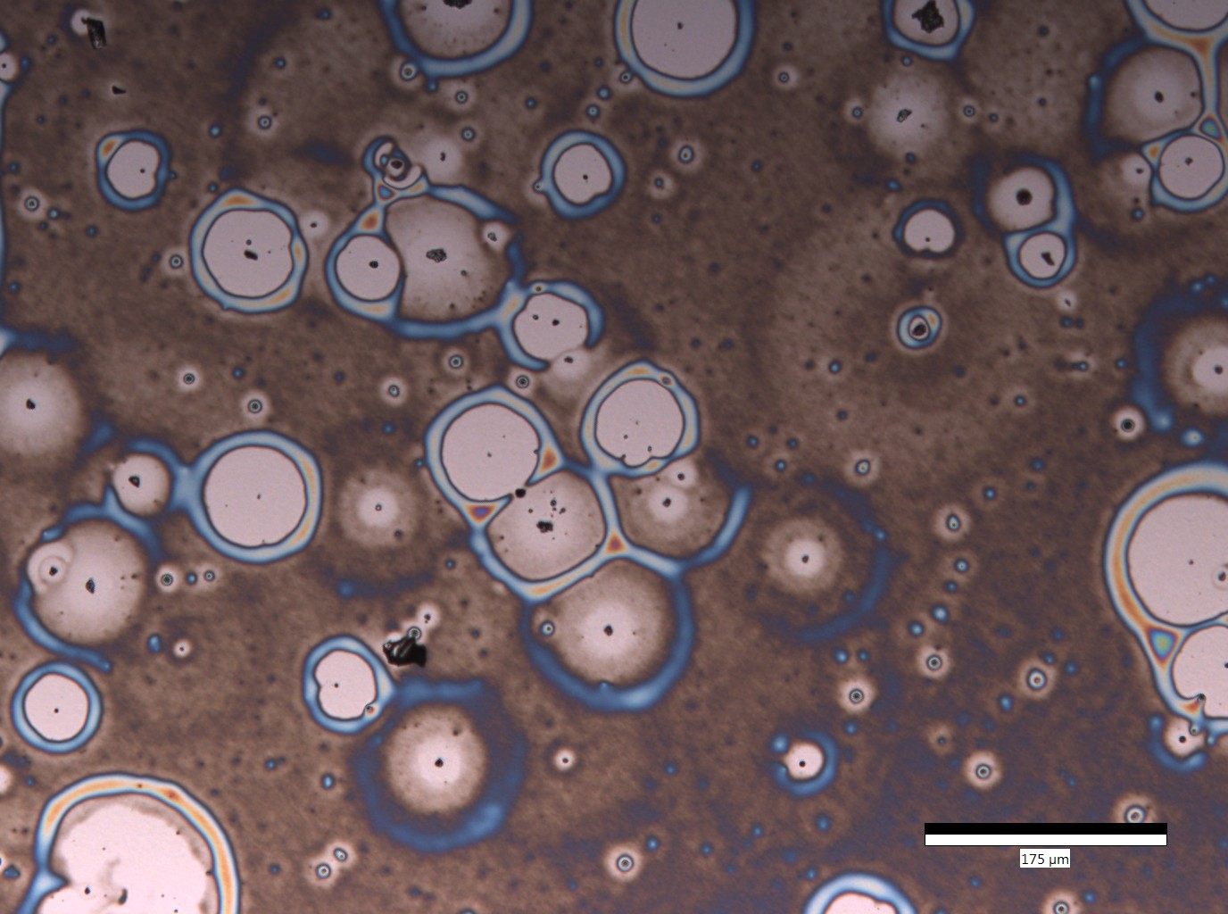
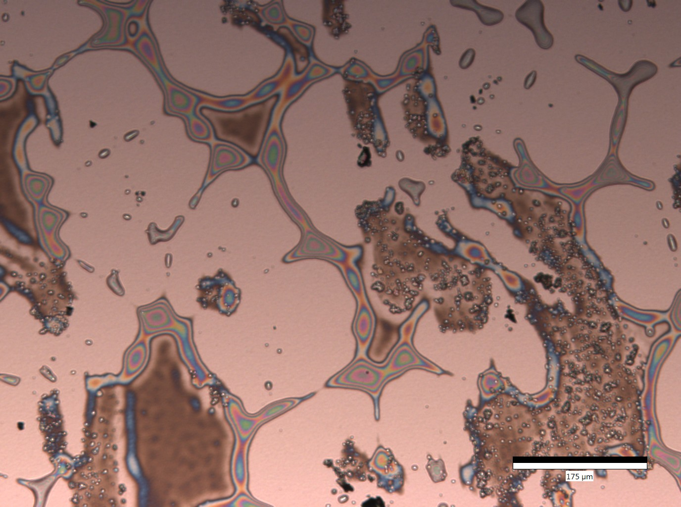
Applied Machine Learning Image Classification
for Dewetting Microscopy
¹ Kim C, ² Sutrisno R, ³ Chua K, ⁴ Karim A, ⁵ Toti G
¹ Brown University, Providence, RI; ² University of Houston, Houston, TX; ³Cornell University, Ithaca, NY; ⁴ Department of
Chemical and Biomolecular Engineering, University of Houston; ⁵ Department of Computer Science, University of Houston
BACKGROUND
FEATURE EXTRACTION
DISCUSSION
With the increasing usage of thin polymer film coatings in industrial applications, there exists a need for a theoretical framework which models the stability of these coatings with respect to certain thermodynamic hyperparameters. Contemporary approaches to model these relations institute a combinatorial approach to exploring the hyperparameter space and quantifying the degree of dewetting manually. To expedite this process, we look at techniques in image processing for feature extraction to use in a machine learning model for classification of dewetting stages based off of optical and spectral microcopy.
Grayscale and saturation images were generated for each image. The effects of unwanted microscopy artifacts were mitigated by normalizing each image dataset by their respective mean filters. Entropy, skewness, and intensity variance values were collected from global (entire image) and local (3x3 striding grid) perspectives, generating a total of twelve features.
CONCLUSION
OBJECTIVES
Extract independent features from microscopy images using image processing techniques
Train a machine learning model for dewetting classification (See Figs. 1-4)
Optimize model hyperparameters to achieve a 90% testing accuracy
Fig. 5: Grayscale Image After
Mean Filter Normalization (MFN)
Fig. 6: Saturation Image after MFN with Striding Grid Representation
MODEL SELECTION
Models Trained with 10-fold CV:
SVM
Neural Network
Decision Tree
Random Forest
1
2
Hyperparameters Gridsearch:
No. of trees
Function measuring split quality
No. of features to consider for split
Fig. 7: Optimal Random Forest
Learning Curve
3
4
FUTURE WORK
REFERENCES
The robustness of the current model can be further improved with transfer learning so that the microscopy image inputs are not limited by microscope specifications, polymer and solvent types, and other environmental factors.
Figs. 1-4: Dewetting Stages (None, Early, Intermediate, Late)

